Slide 1
Cloud9 IDE Social Media Presence
This is what your brand presence could look like on social media

Slide 2
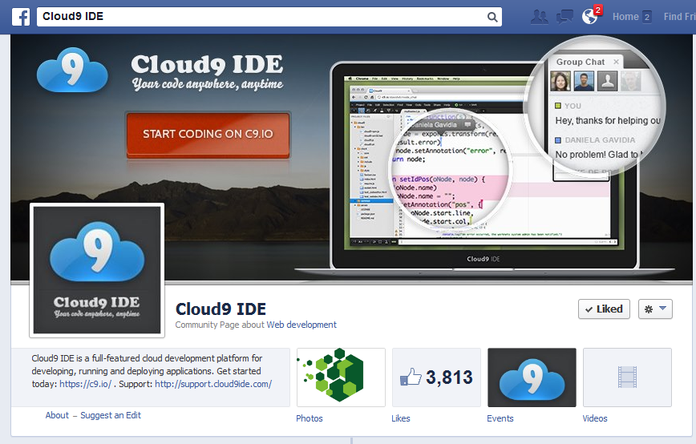
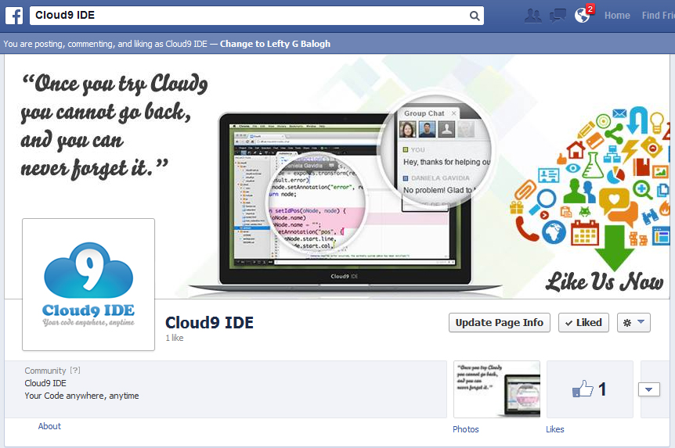
Facebook
Before
After

Slide 3
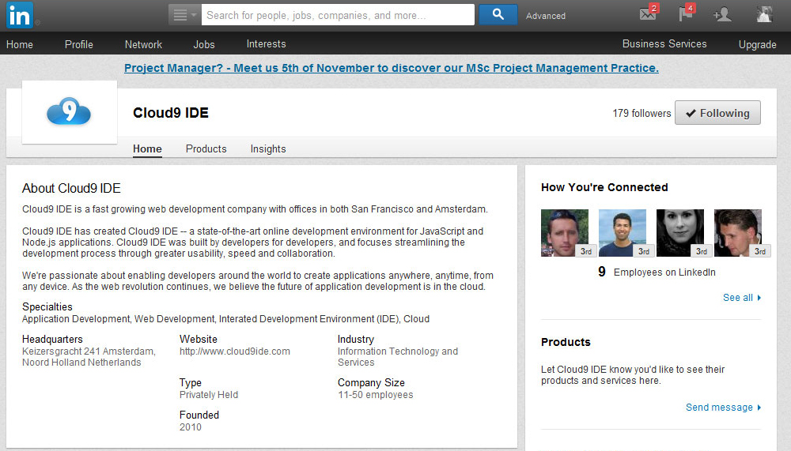
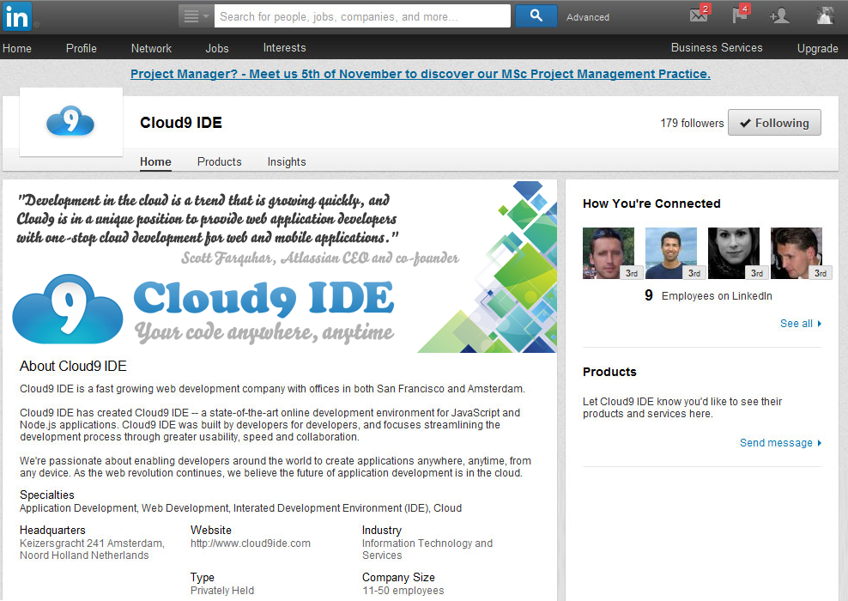
LinkedIn
Before
After

Slide 4
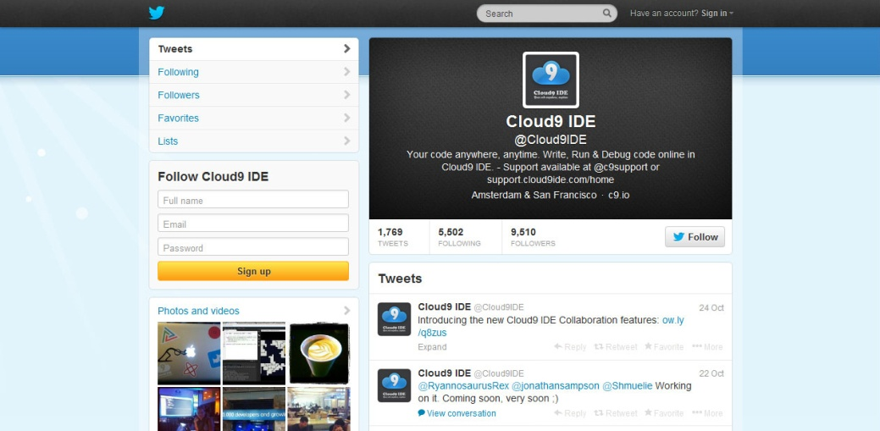
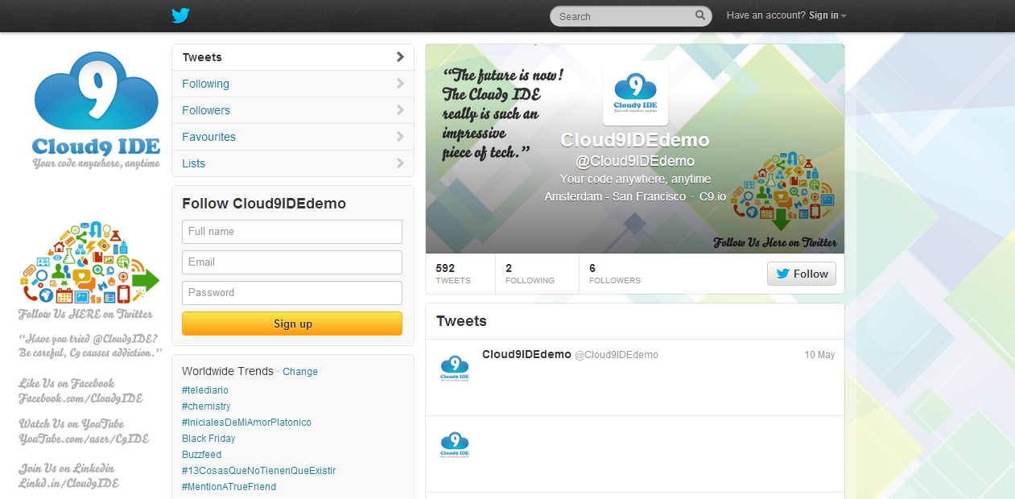
Twitter
Before
After

Slide 5
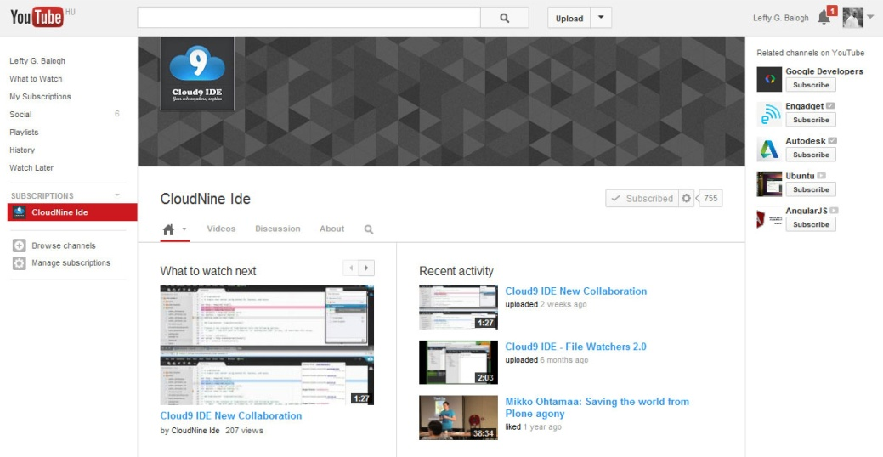
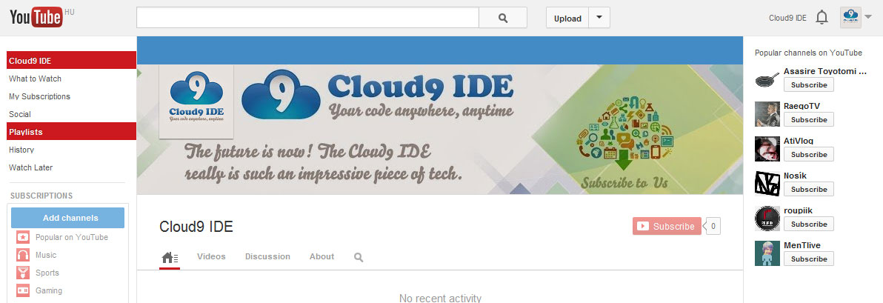
YouTube
Before
After

Slide 6
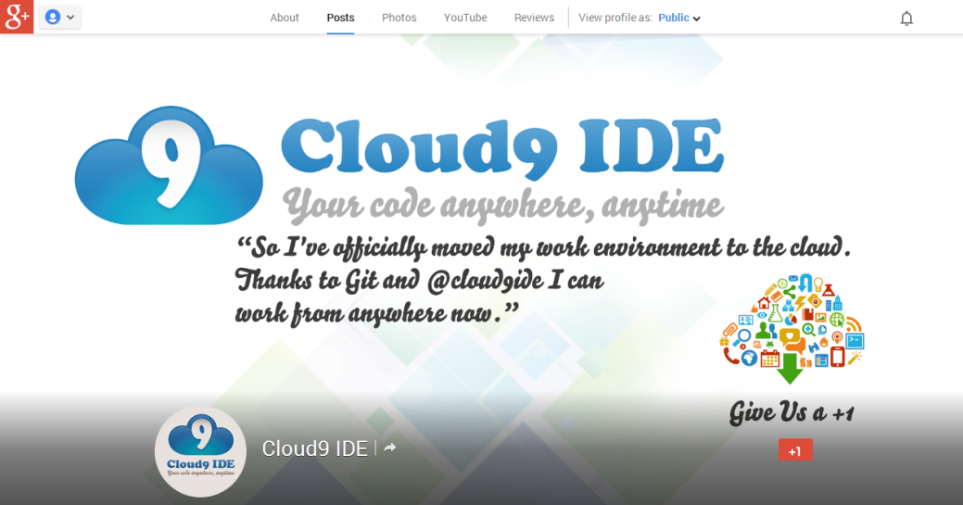
Google Plus Page
Before
After

Slide 7
What to do next?
Drop me an email, let’s talk to see how I could help: leftygbalogh@gmail.com

